Slide 1
Dynamics and Control of a Quadrotor with Active Geometric Morphing
Dustin Wallace, Kristi Morgansen
Nonlinear Dynamics and Control Laboratory
University of Washington - William E. Boeing Aeronautics and Astronautics
MSAA Thesis Presentation – 9 March 2016

Slide 2
Overview
Motivation and Objectives
Proceeding Work
Model Definition
Dynamic Analysis
LQR Control
Set Point LQR Gain Scheduling
Numerical Optimal Geometric Morphing
Conclusions and Suggestions for Further Study
Acknowledgements
References

Slide 3
Motivation and Objectives
Motivation
Unique Capabilities Presented by Robodub’s Patented Design
Equal-Thrust Load Balancing
Narrow Gap Navigation
Motor Loss Recovery
Novel Single-Thrust Input Attitude Actuation
Objectives
Develop Analytical Dynamic Model
Develop Control Strategies for Demonstrating Unique Capabilities

Slide 4
Proceeding Work
LQR Quadrotor Control
LQR and PID Comparison in Early Quadrotor Work
Bouabdallah, Noth, and Siegwart [2004]
Quadrotors with Dynamic Inertia
Quadrotor with Free-Swinging Payload
Sadr, Moosavian, Zarafshan [2014]
Quadrotor Compensating for Actuated Arm
Jimenez-Cano, Martin, Heredia, Ollero, Cano [2013]
Use of Actuated Pendulum to Achieve Pitch and Roll Control
Becker [2013]
Roll-Pitch Actuated Tiltrotor Quadrotor
Senkul, Altug [2013]

Slide 5
Overview
Motivation and Objectives
Proceeding Work
Model Definition
Dynamic Analysis
LQR Control
Set Point LQR Gain Scheduling
Numerical Optimal Geometric Morphing
Conclusions and Suggestions for Further Study
Acknowledgements
References

Slide 6
Model Definition
9 Total Masses
Cylindrical Quadrotor Body
4 Arms
Able to Rotate About Their Bases
Modeled as Thin Rods
4 Motors
Able to Slide Along Their Arms
Modeled as Point Masses

Slide 7
Model Definition
Arm Designators
A, B, C, D
Geometric Definitions
Body Radius, ρ_{Body}
Body Height, h_{Body}
Arm Pivot Base Distances
b_{A} , b_{B} , b_{C} , b_{D}
Arm Lengths
l_{A} , l_{B} , l_{C} , l_{D}
Arm Angles
α_{A} , α_{B} , α_{C} , α_{D}
Motor Positions
d_{A} , d_{B} , d_{C} , d_{D}
A
α_{B}
ρ_{Body}
d_{D}
b_{B}
D
B
l_{C}
C

Slide 8
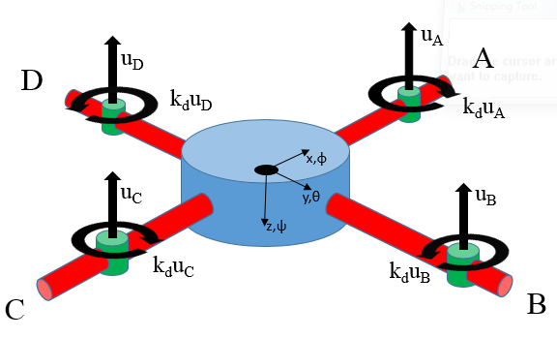
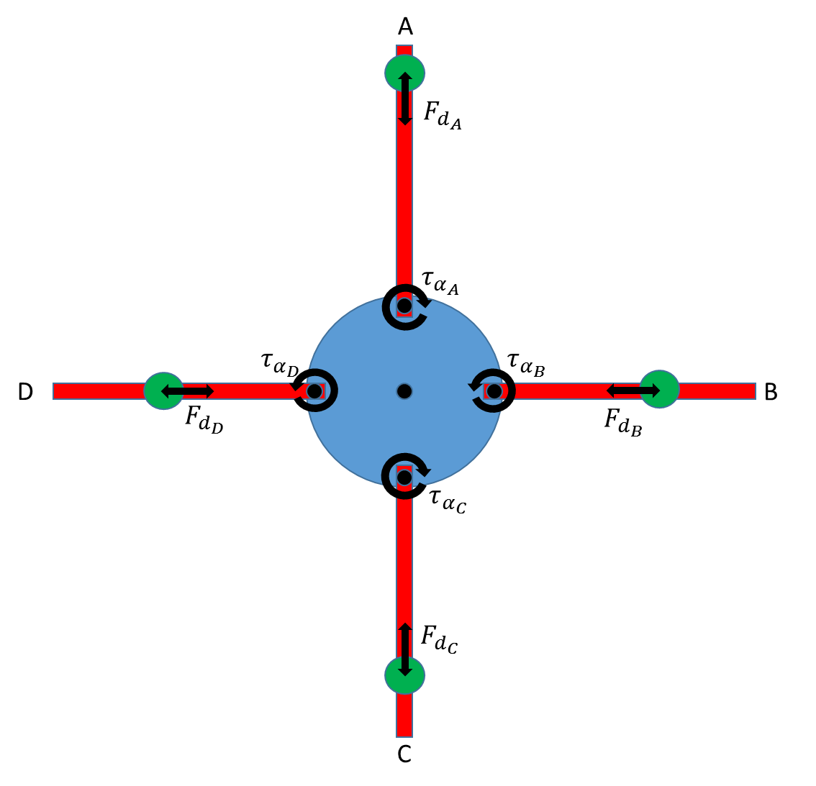
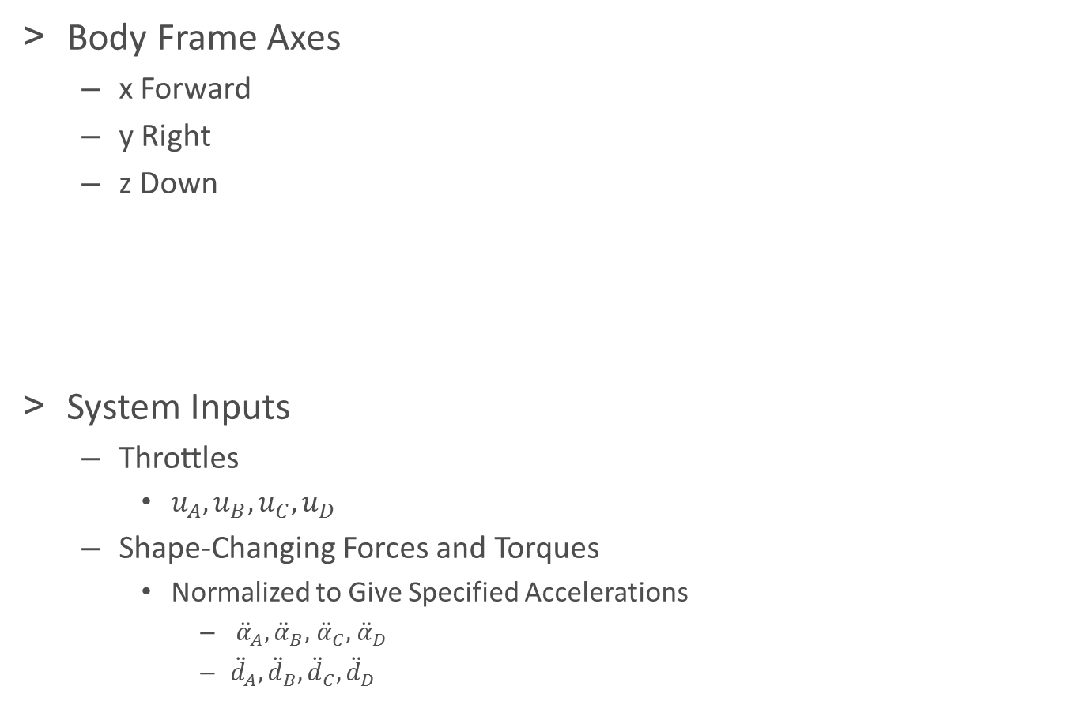
Model Definition
Body Frame Axes
x Forward
y Right
z Down
System Inputs
Throttles
$u_{A},u_{B},u_{C},u_{D}$
Shape-Changing Forces and Torques
Normalized to Give Specified Accelerations
${\ddot{α}}_{A},{\ddot{α}}_{B},$ ${\ddot{α}}_{C},$ ${\ddot{α}}_{D}$
${\ddot{d}}_{A},{\ddot{d}}_{B},{\ddot{d}}_{C},{\ddot{d}}_{D}$

Slide 9
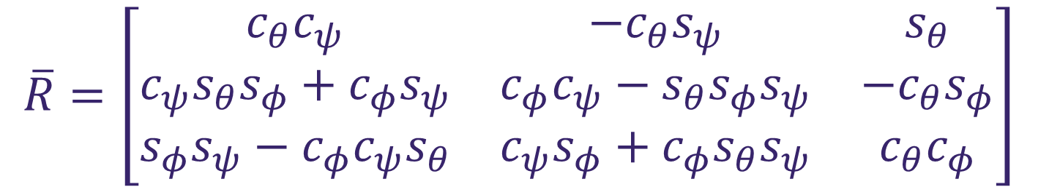
Model Definition
Rotation Matrix
Roll-Pitch-Yaw Euler Angles Selected
$$\overline{R}=\left[\begin{matrix}c_{θ}c_{ψ} & −c_{θ}s_{ψ} & s_{θ} \\ c_{ψ}s_{θ}s_{φ}+c_{φ}s_{ψ} & c_{φ}c_{ψ}−s_{θ}s_{φ}s_{ψ} & −c_{θ}s_{φ} \\ s_{φ}s_{ψ}−c_{φ}c_{ψ}s_{θ} & c_{ψ}s_{φ}+c_{φ}s_{θ}s_{ψ} & c_{θ}c_{φ}\end{matrix}\right]$$

Slide 10
Overview
Motivation and Objectives
Proceeding Work
Model Definition
Dynamic Analysis
LQR Control
Set Point LQR Gain Scheduling
Numerical Optimal Geometric Morphing
Conclusions and Suggestions for Further Study
Acknowledgements
References

Slide 11
Generalized Coordinates
9 Masses Correspond to 54 DOF in Newtonian 3-Space
Joint Constraints Can be Used to Reduce the System to a Minimum Number of Generalized Coordinates
Arm Pivot Bases Only Allow Relative Yaw, Eliminating 20 DOF
Sliding Motor Joints Allow Only Unidimensional Translation, Eliminating another 20 DOF
This Leaves the System 14 DOF
6 Body States
8 Shape States
$$\overset{⃑}{q}={\left[x,y,z,φ,θ,ψ,α_{A},α_{B},α_{C},α_{D},d_{A},d_{B},d_{C},d_{D}\right]}^{T}$$

Slide 12
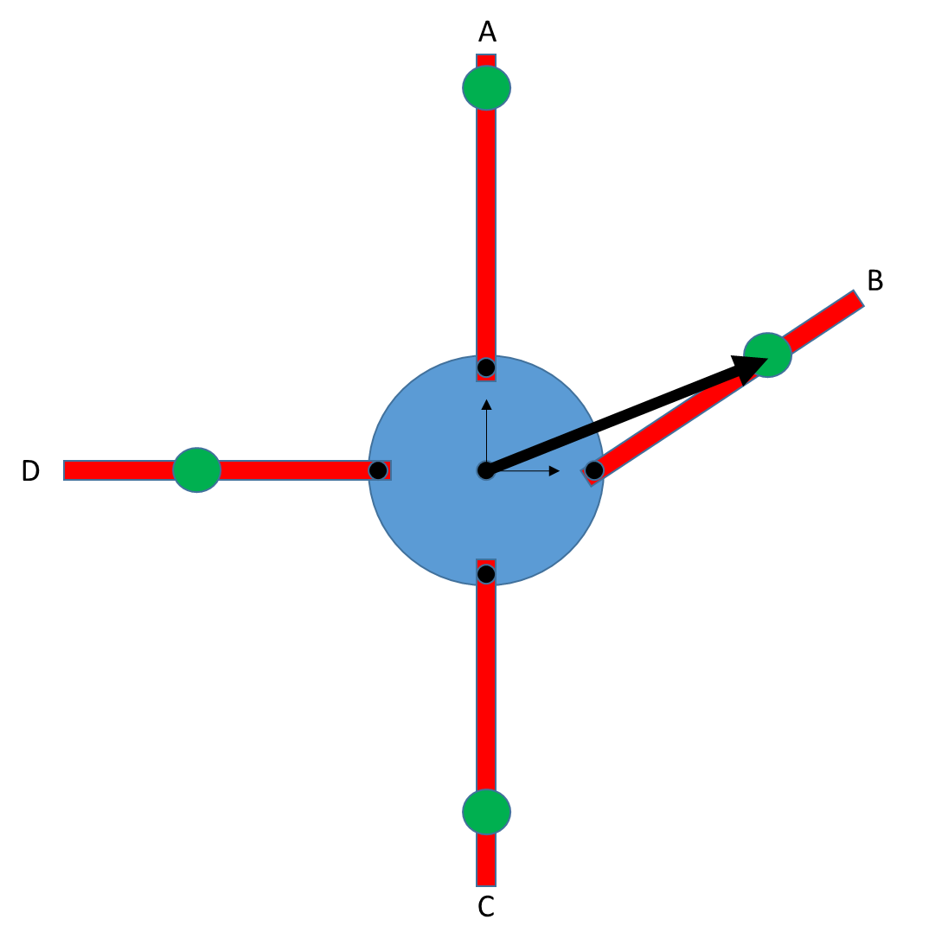
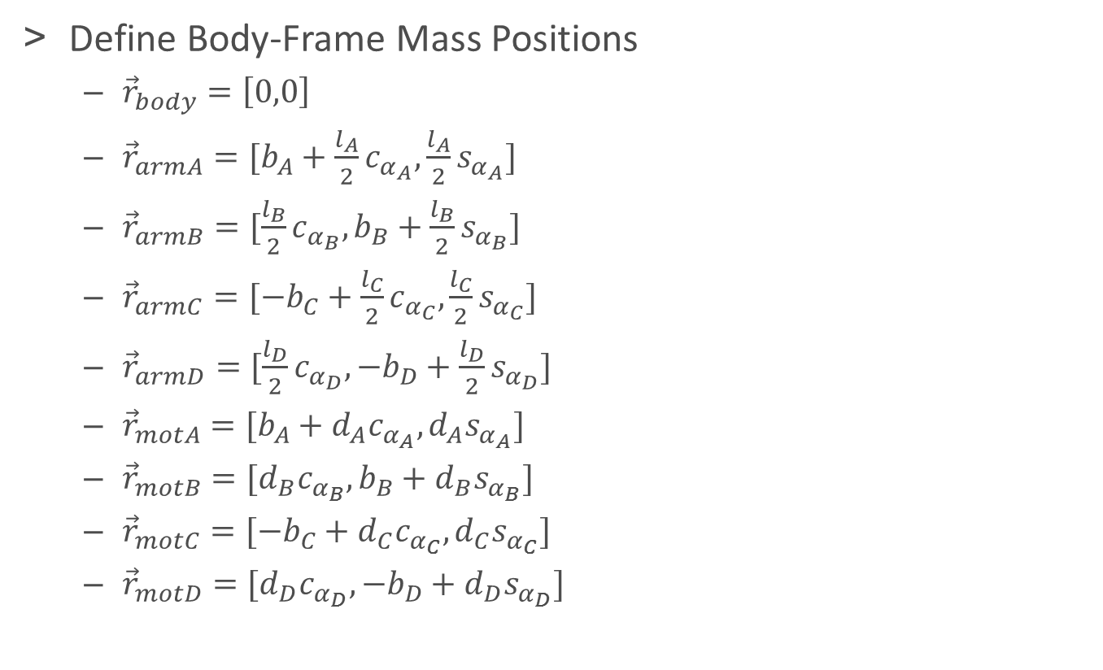
System Dynamics
Define Body-Frame Mass Positions
${\vec{r}}_{body}=\left[0,0\right]$
${\vec{r}}_{armA}=[b_{A}+\frac{l_{A}}{2}c_{α_{A}},\frac{l_{A}}{2}s_{α_{A}}]$
${\vec{r}}_{armB}=[\frac{l_{B}}{2}c_{α_{B}},b_{B}+\frac{l_{B}}{2}s_{α_{B}}]$
${\vec{r}}_{armC}=[{−b}_{C}+\frac{l_{C}}{2}c_{α_{C}},\frac{l_{C}}{2}s_{α_{C}}]$
${\vec{r}}_{armD}=[\frac{l_{D}}{2}c_{α_{D}},{−b}_{D}+\frac{l_{D}}{2}s_{α_{D}}]$
${\vec{r}}_{motA}=[b_{A}+d_{A}c_{α_{A}},d_{A}s_{α_{A}}]$
${\vec{r}}_{motB}=[d_{B}c_{α_{B}},b_{B}+d_{B}s_{α_{B}}]$
${\vec{r}}_{motC}=[{−b}_{C}+d_{C}c_{α_{C}},d_{C}s_{α_{C}}]$
${\vec{r}}_{motD}=[d_{D}c_{α_{D}},{−b}_{D}+d_{D}s_{α_{D}}]$

Slide 13
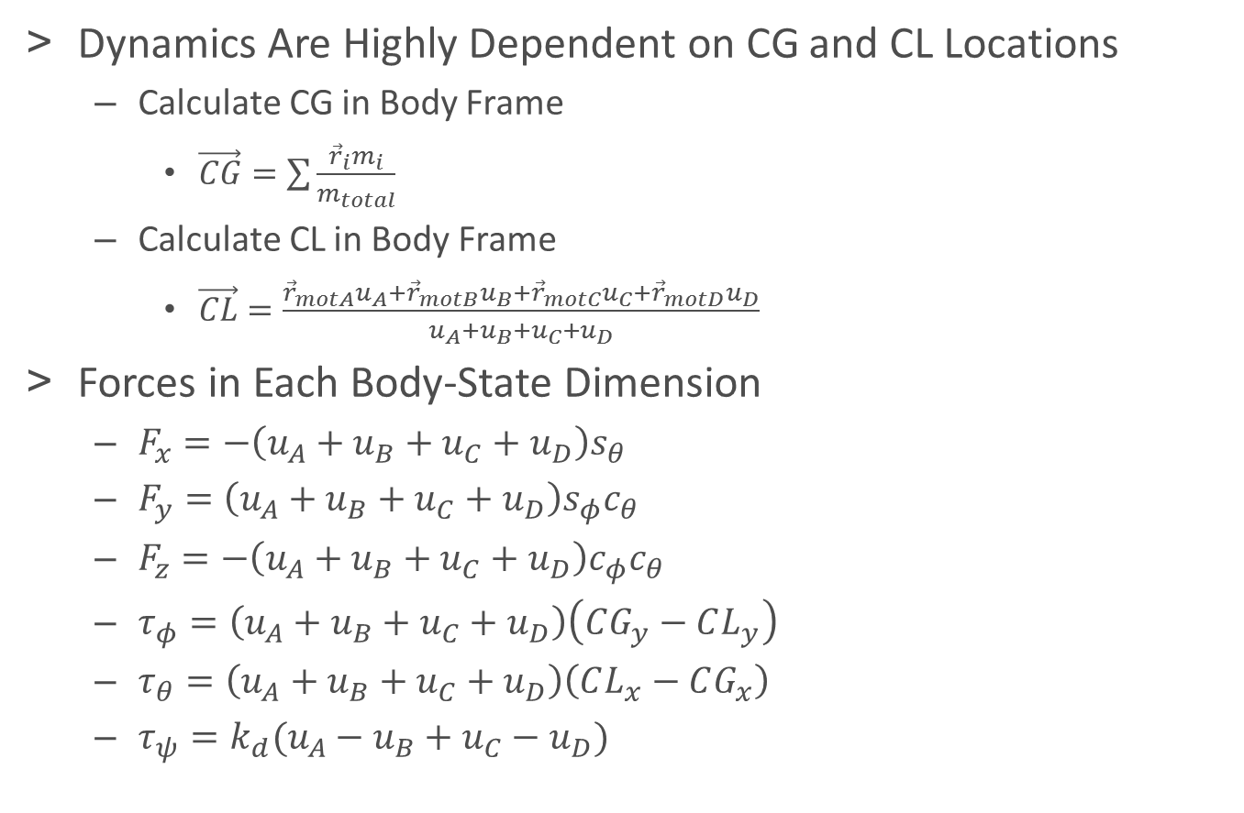
System Dynamics
Dynamics Are Highly Dependent on CG and CL Locations
Calculate CG in Body Frame
$\vec{CG}=\sum{\frac{{\vec{r}}_{i}m_{i}}{m_{total}}}$
Calculate CL in Body Frame
$\vec{CL}=\frac{{\vec{r}}_{motA}u_{A}+{\vec{r}}_{motB}u_{B}+{\vec{r}}_{motC}u_{C}+{\vec{r}}_{motD}u_{D}}{u_{A}+u_{B}+u_{C}+u_{D}}$
Forces in Each Body-State Dimension
$F_{x}=−\left(u_{A}+u_{B}+u_{C}+u_{D}\right)s_{θ}$
$F_{y}=\left(u_{A}+u_{B}+u_{C}+u_{D}\right)s_{φ}c_{θ}$
$F_{z}=−\left(u_{A}+u_{B}+u_{C}+u_{D}\right)c_{φ}c_{θ}$
$τ_{φ}=\left(u_{A}+u_{B}+u_{C}+u_{D}\right)\left(CG_{y}−CL_{y}\right)$
$τ_{θ}=\left(u_{A}+u_{B}+u_{C}+u_{D}\right)\left(CL_{x}−CG_{x}\right)$
$τ_{ψ}=k_{d}(u_{A}−u_{B}+u_{C}−u_{D})$

Slide 14
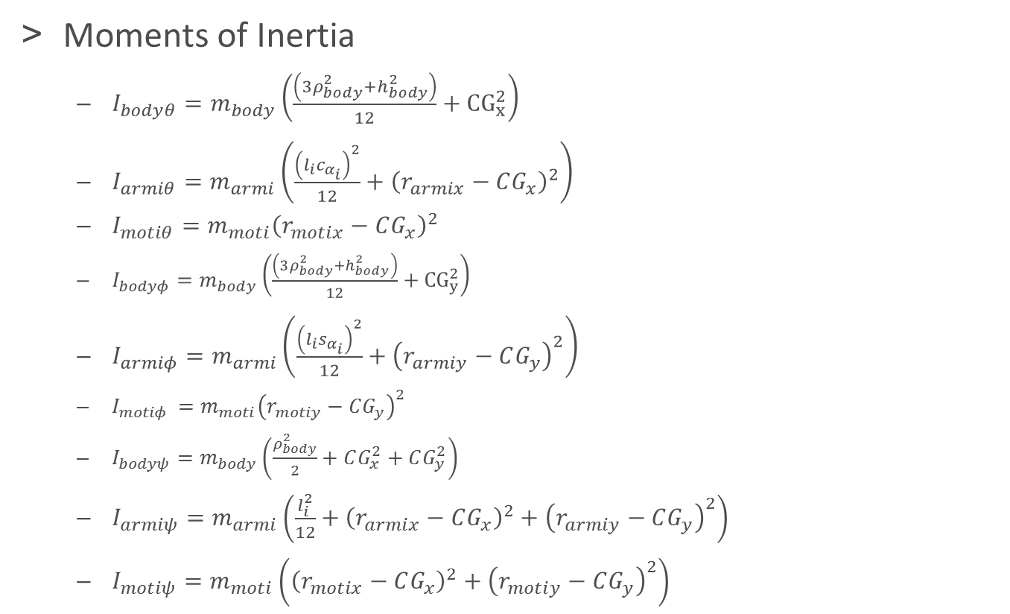
System Dynamics
Moments of Inertia
$I_{bodyθ}=m_{body}\left(\frac{\left(3ρ_{body}^{2}+h_{body}^{2}\right)}{12}+{CG}_{x}^{2}\right)$
$I_{armiθ}=m_{armi}\left(\frac{{\left(l_{i}c_{α_{i}}\right)}^{2}}{12}+{\left(r_{armix}−CG_{x}\right)}^{2}\right)$
$I_{motiθ}=m_{moti}{\left(r_{motix}−CG_{x}\right)}^{2}$
$I_{bodyφ}=m_{body}\left(\frac{\left(3ρ_{body}^{2}+h_{body}^{2}\right)}{12}+{CG}_{y}^{2}\right)$
$I_{armiφ}=m_{armi}\left(\frac{{\left(l_{i}s_{α_{i}}\right)}^{2}}{12}+{\left(r_{armiy}−CG_{y}\right)}^{2}\right)$
$I_{motiφ }=m_{moti}{\left(r_{motiy}−CG_{y}\right)}^{2}$
$I_{bodyψ}=m_{body}\left(\frac{ρ_{body}^{2}}{2}+CG_{x}^{2}+CG_{y}^{2}\right)$
$I_{armiψ}=m_{armi}\left(\frac{l_{i}^{2}}{12}+{\left(r_{armix}−CG_{x}\right)}^{2}+{\left(r_{armiy}−CG_{y}\right)}^{2}\right)$
$I_{motiψ}=m_{moti}\left({\left(r_{motix}−CG_{x}\right)}^{2}+{\left(r_{motiy}−CG_{y}\right)}^{2}\right)$

Slide 15
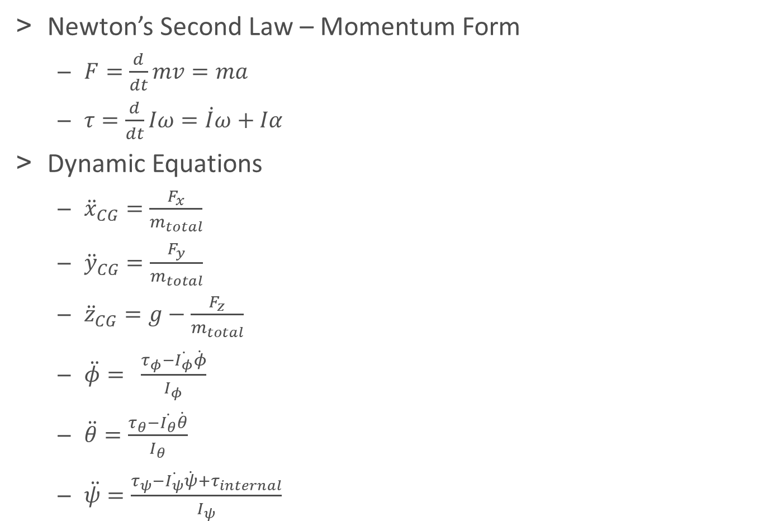
System Dynamics
Newton’s Second Law – Momentum Form
$F=\frac{d}{dt}mv=ma$
$τ=\frac{d}{dt}Iω=\dot{I}ω+Iα$
Dynamic Equations
${\ddot{x}}_{CG}=\frac{F_{x}}{m_{total}}$
${\ddot{y}}_{CG}=\frac{F_{y}}{m_{total}}$
${\ddot{z}}_{CG}=g−\frac{F_{z}}{m_{total}}$
$\ddot{φ}= \frac{τ_{φ}−\dot{I_{φ}}\dot{φ}}{I_{φ}}$
$\ddot{θ}=\frac{τ_{θ}−\dot{I_{θ}}\dot{θ}}{I_{θ}}$
$\ddot{ψ}=\frac{τ_{ψ}−\dot{I_{ψ}}\dot{ψ}+τ_{internal}}{I_{ψ}}$

Slide 16
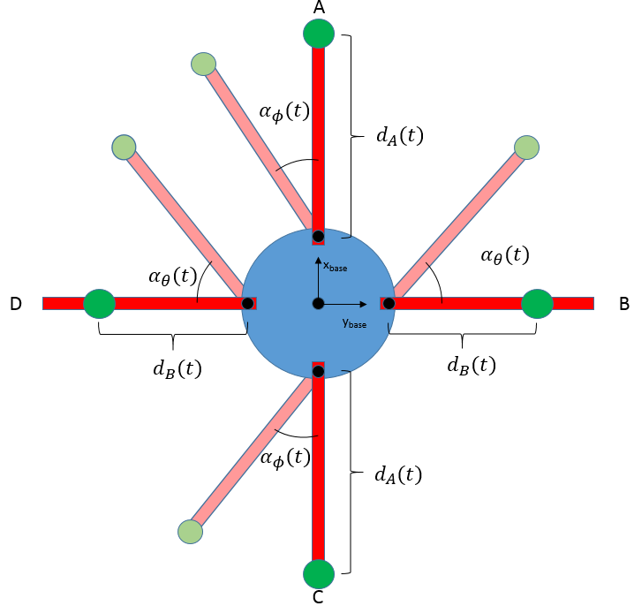
System Dynamics
Internal Torque Considerations
Torques resulting from prescribed arm and motor movements are difficult to quantify.
Symmetry Assumptions are Implemented to Cancel Internal Torques

Slide 17
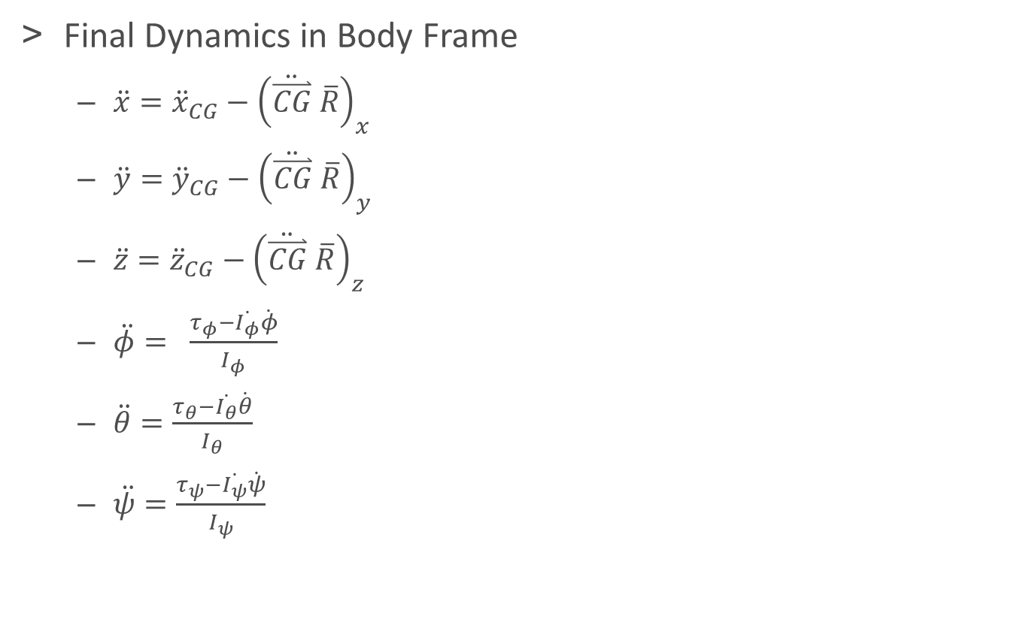
System Dynamics
Final Dynamics in Body Frame
$\ddot{x}={\ddot{x}}_{CG}−{\left(\ddot{\overset{⃑}{CG}} \overline{R}\right)}_{x}$
$\ddot{y}={\ddot{y}}_{CG}−{\left(\ddot{\overset{⃑}{CG}} \overline{R}\right)}_{y}$
$\ddot{z}={\ddot{z}}_{CG}−{\left(\ddot{\overset{⃑}{CG}} \overline{R}\right)}_{z}$
$\ddot{φ}= \frac{τ_{φ}−\dot{I_{φ}}\dot{φ}}{I_{φ}}$
$\ddot{θ}=\frac{τ_{θ}−\dot{I_{θ}}\dot{θ}}{I_{θ}}$
$\ddot{ψ}=\frac{τ_{ψ}−\dot{I_{ψ}}\dot{ψ}}{I_{ψ}}$

Slide 18
Overview
Motivation and Objectives
Proceeding Work
Model Definition
Dynamic Analysis
LQR Control
Set Point LQR Gain Scheduling
Numerical Optimal Geometric Morphing
Conclusions and Suggestions for Further Study
Acknowledgements
References

Slide 19
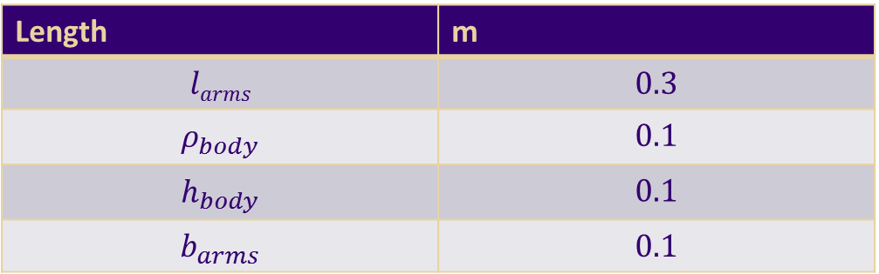
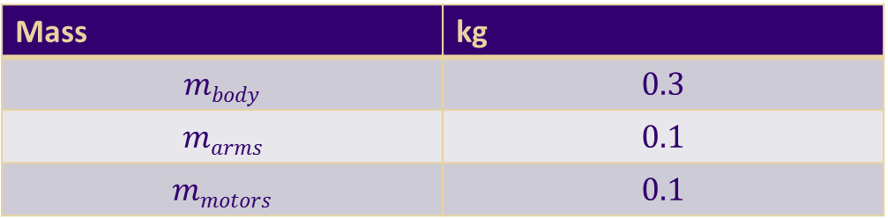

LQR Design
Numerical Values Are Assigned to Parameters, Estimated for a Hobby-Sized Quadrotor
Mass | kg
$$mbody$$ | $$0.3$$
$$marms$$ | $$0.1$$
$$mmotors$$ | $$0.1$$
Length | m
$$larms$$ | $$0.3$$
$$ρ_{body}$$ | $$0.1$$
$$h_{body}$$ | $$0.1$$
$$b_{arms}$$ | $$0.1$$
Prop Drag Coefficient
$$k_{d}$$ | $$0.5$$

Slide 20
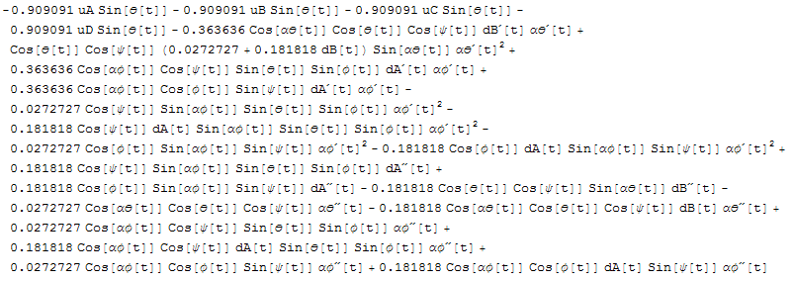
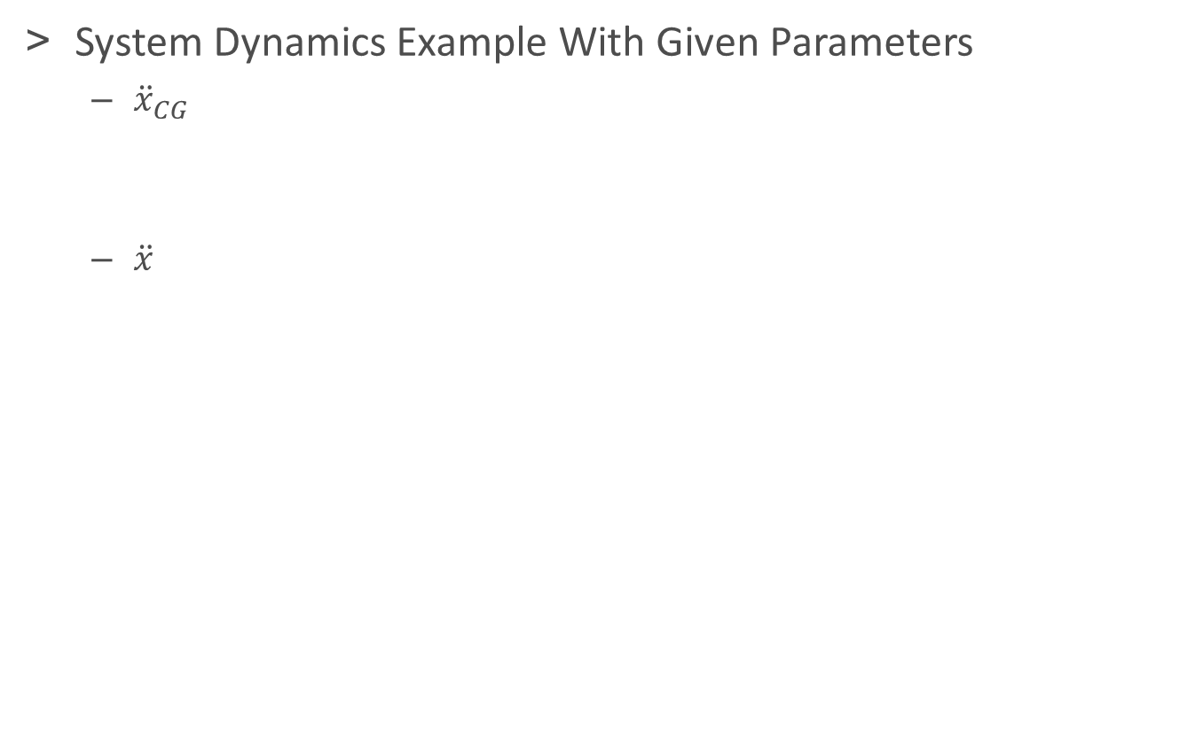
LQR Design
System Dynamics Example With Given Parameters
${\ddot{x}}_{CG}$
$\ddot{x}$

Slide 21
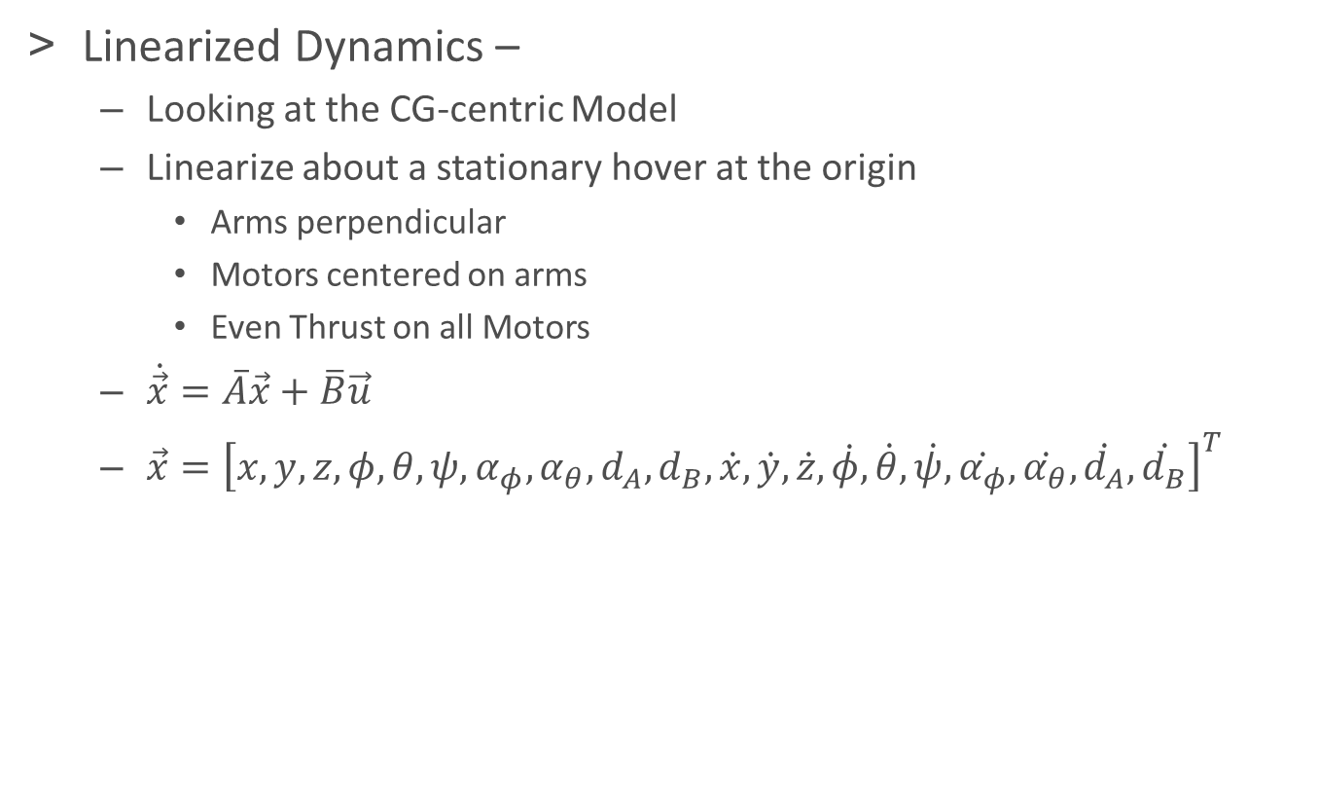
LQR Design
Linearized Dynamics –
Looking at the CG-centric Model
Linearize about a stationary hover at the origin
Arms perpendicular
Motors centered on arms
Even Thrust on all Motors
$\dot{\vec{x}}=\overline{A}\vec{x}+\overline{B}\vec{u}$
$\vec{x}={\left[x,y,z,φ,θ,ψ,α_{φ},α_{θ},d_{A},d_{B},\dot{x},\dot{y},\dot{z},\dot{φ},\dot{θ},\dot{ψ},\dot{α_{φ}},\dot{α_{θ}},\dot{d_{A}},\dot{d_{B}}\right]}^{T}$

Slide 22
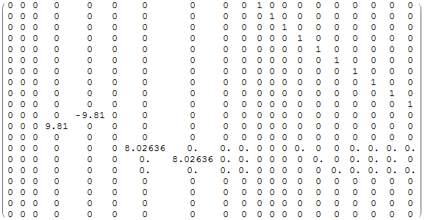


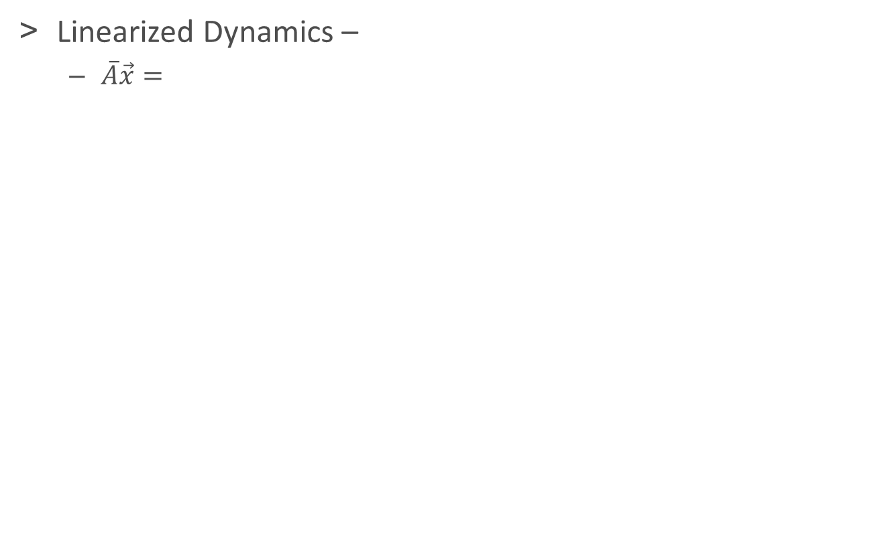


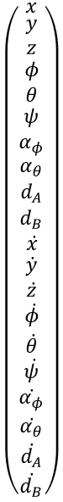
LQR Design
Linearized Dynamics –
$\overline{A}\vec{x}=$
$$\left(\begin{matrix}\begin{matrix}x \\ \begin{matrix}y \\ z\end{matrix} \\ φ\end{matrix} \\ θ \\ \begin{matrix}ψ \\ α_{φ} \\ \begin{matrix}α_{θ} \\ d_{A} \\ \begin{matrix}d_{B} \\ ẋ \\ \begin{matrix}\dot{y} \\ \dot{z} \\ \begin{matrix}\dot{φ} \\ \dot{θ} \\ \begin{matrix}\dot{ψ} \\ \dot{α_{φ}} \\ \begin{matrix}\dot{α_{θ}} \\ \dot{d_{A}} \\ \dot{d_{B}}\end{matrix}\end{matrix}\end{matrix}\end{matrix}\end{matrix}\end{matrix}\end{matrix}\end{matrix}\right)$$
$$\ddot{x}$$
$$\ddot{y}$$
$$\ddot{φ}$$
$$\ddot{θ}$$

Slide 23
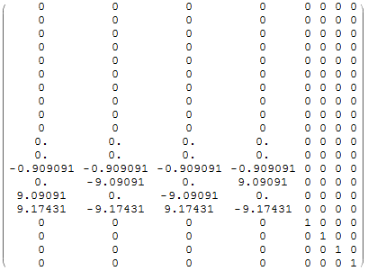





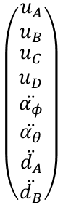
LQR Design
Linearized Dynamics –
$\overline{B}\vec{u}=$
$$\left(\begin{matrix}u_{A} \\ u_{B} \\ \begin{matrix}u_{C} \\ u_{D} \\ \begin{matrix}\ddot{α_{φ}} \\ \ddot{α_{θ}} \\ \begin{matrix}\ddot{d_{A}} \\ \ddot{d_{B}}\end{matrix}\end{matrix}\end{matrix}\end{matrix}\right)$$
$$\ddot{z}$$
$$\ddot{φ}$$
$$\ddot{θ}$$
$$\ddot{ψ}$$

Slide 24
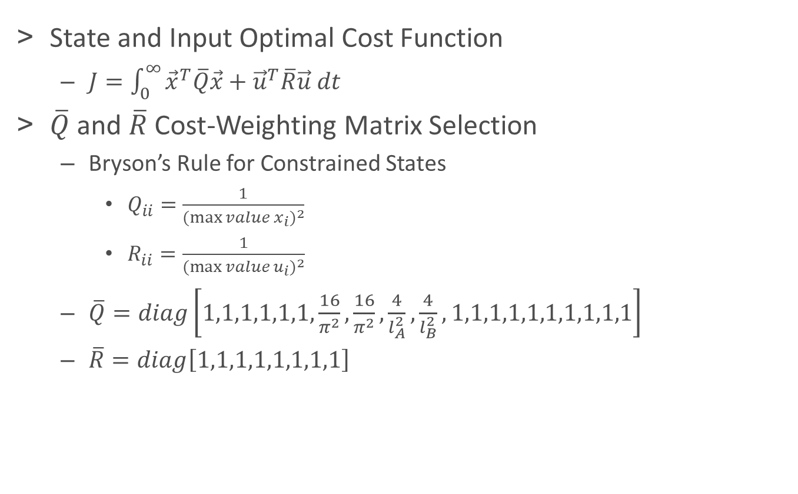
LQR Design
State and Input Optimal Cost Function
$J=\int_{0}^{∞}{{\vec{x}}^{T}\overline{Q}\vec{x}+{\vec{u}}^{T}\overline{R}\vec{u} dt}$
$\overline{Q}$ and $\overline{R}$ Cost-Weighting Matrix Selection
Bryson’s Rule for Constrained States
$Q_{ii}=\frac{1}{{(\max{value x_{i})}}^{2}}$
$R_{ii}=\frac{1}{{(\max{value u_{i})}}^{2}}$
$\overline{Q}=diag\left[1,1,1,1,1,1,\frac{16}{π^{2}},\frac{16}{π^{2}},\frac{4}{l_{A}^{2}},\frac{4}{l_{B}^{2}}, 1,1,1,1,1,1,1,1,1,1\right]$
$\overline{R}=diag\left[1,1,1,1,1,1,1,1\right]$

Slide 25
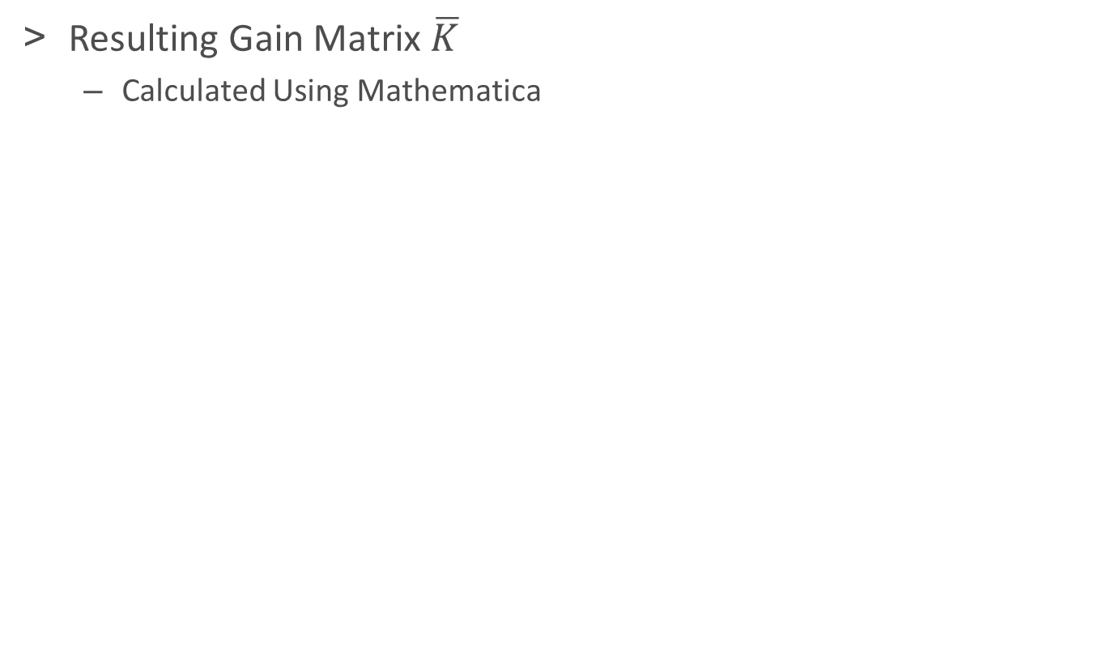
LQR Design
Resulting Gain Matrix $\overline{K}$
Calculated Using Mathematica

Slide 26
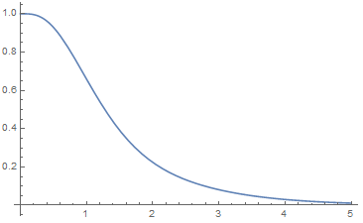
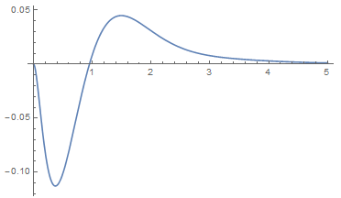
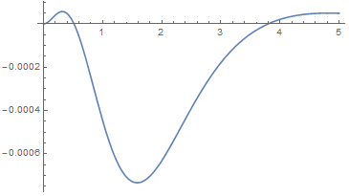
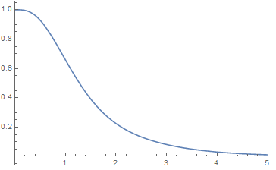
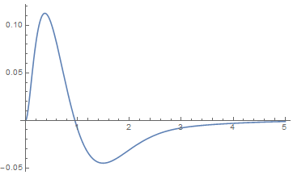
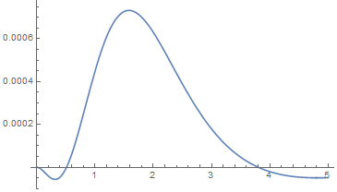
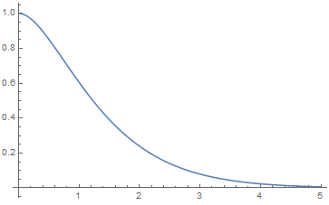
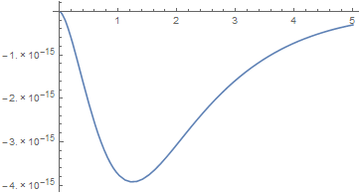
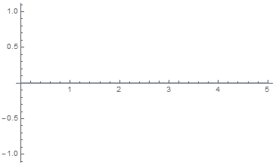


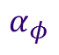


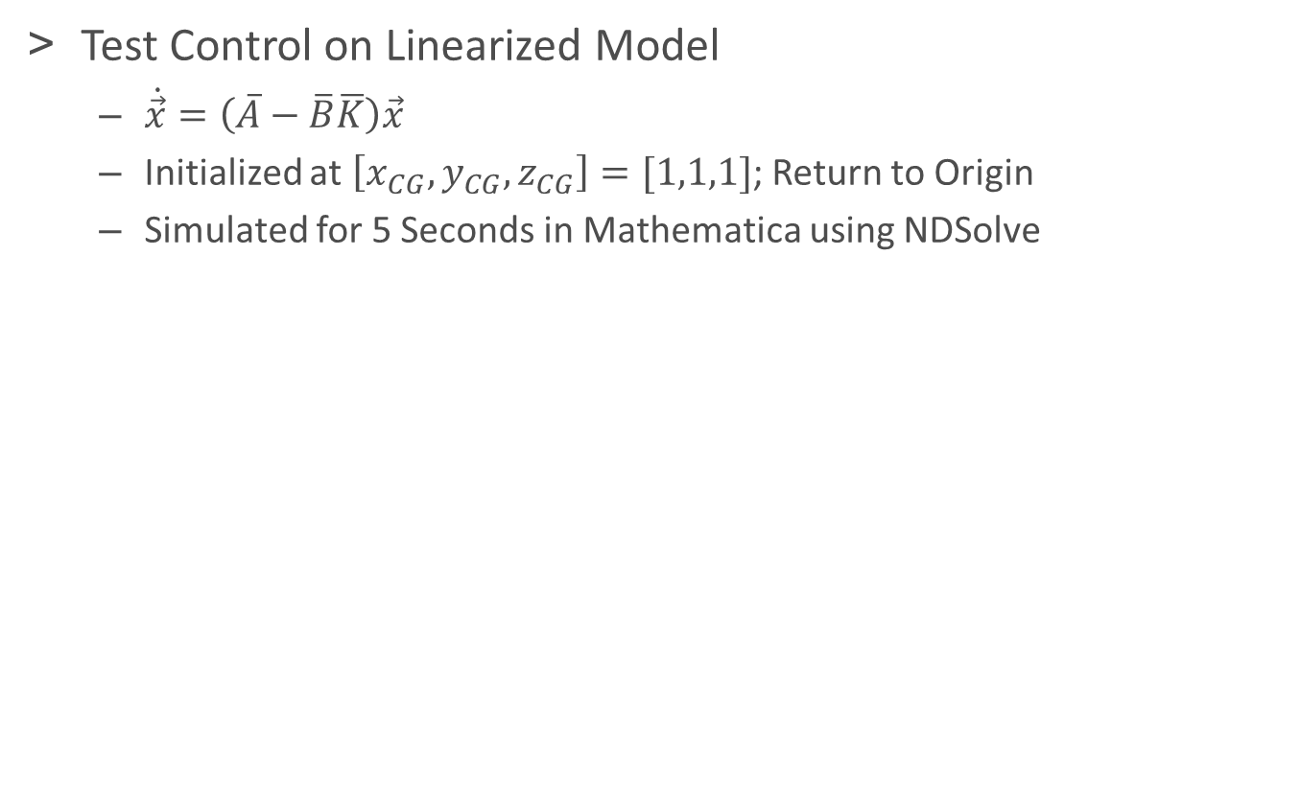
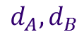

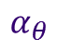

LQR Evaluation
Test Control on Linearized Model
$\dot{\vec{x}}=\left(\overline{A}−\overline{B}\overline{K}\right)\vec{x}$
Initialized at $\left[x_{CG},y_{CG},z_{CG}\right]=[1,1,1]$; Return to Origin
Simulated for 5 Seconds in Mathematica using NDSolve
$$x$$
$$φ$$
$$α_{φ}$$
$$y$$
$$θ$$
$$α_{θ}$$
$$z$$
$$ψ$$
$$d_{A},d_{B}$$

Slide 27
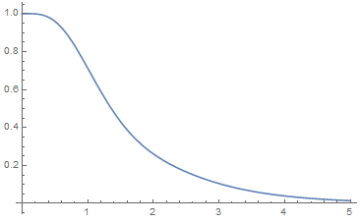
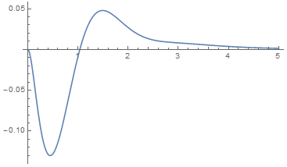
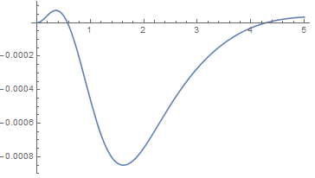
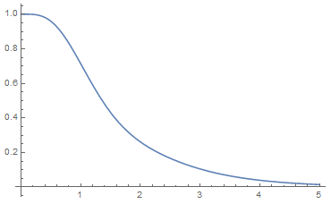
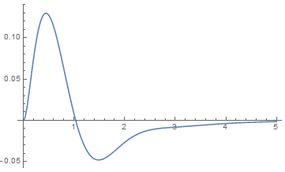
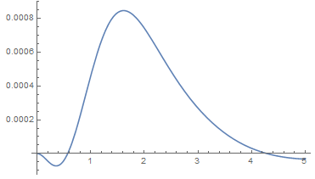
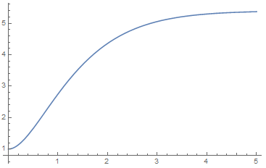
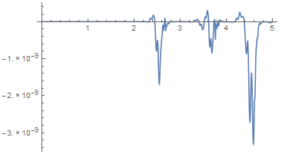
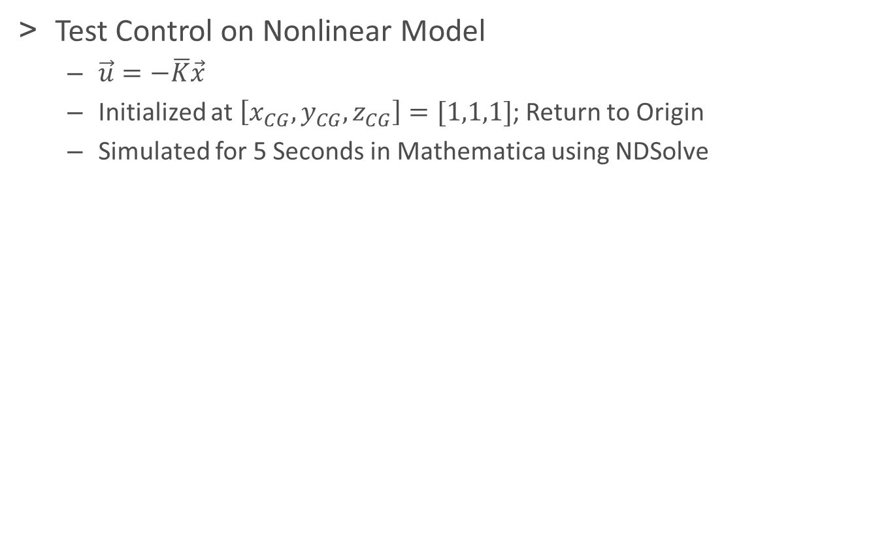
LQR Evaluation
Test Control on Nonlinear Model
$\vec{u}=−\overline{K}\vec{x}$
Initialized at $\left[x_{CG},y_{CG},z_{CG}\right]=[1,1,1]$; Return to Origin
Simulated for 5 Seconds in Mathematica using NDSolve
$$x$$
$$φ$$
$$α_{φ}$$
$$y$$
$$θ$$
$$α_{θ}$$
$$z$$
$$ψ$$
$$d_{A},d_{B}$$

Slide 28
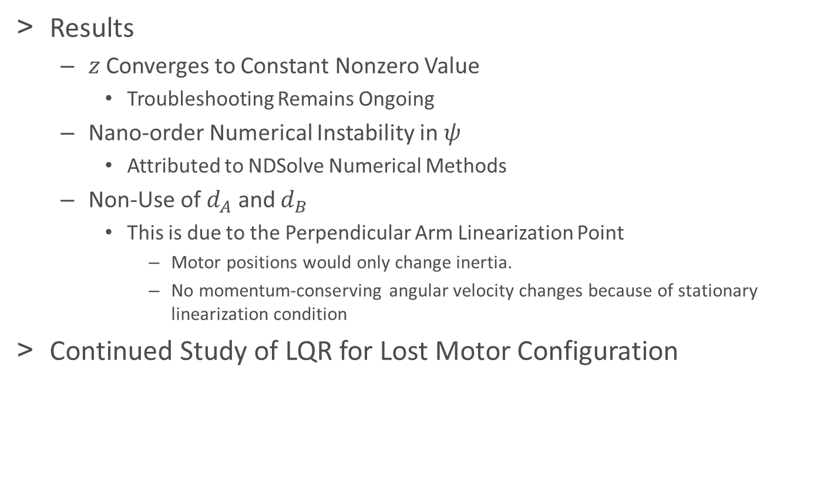
LQR Evaluation
Results
$z$ Converges to Constant Nonzero Value
Troubleshooting Remains Ongoing
Nano-order Numerical Instability in $ψ$
Attributed to NDSolve Numerical Methods
Non-Use of $d_{A}$ and $d_{B}$
This is due to the Perpendicular Arm Linearization Point
Motor positions would only change inertia.
No momentum-conserving angular velocity changes because of stationary linearization condition
Continued Study of LQR for Lost Motor Configuration

Slide 29
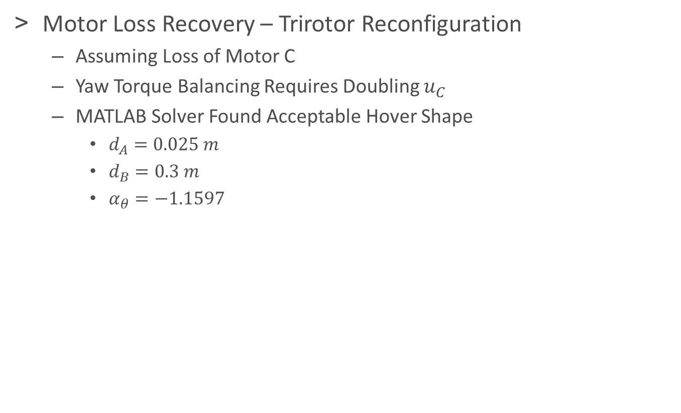
LQR Design
Motor Loss Recovery – Trirotor Reconfiguration
Assuming Loss of Motor C
Yaw Torque Balancing Requires Doubling $u_{C}$
MATLAB Solver Found Acceptable Hover Shape
$d_{A}=0.025 m$
$d_{B}=0.3 m$
$α_{θ}=−1.1597$

Slide 30
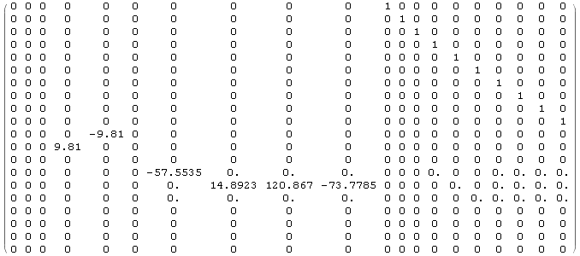


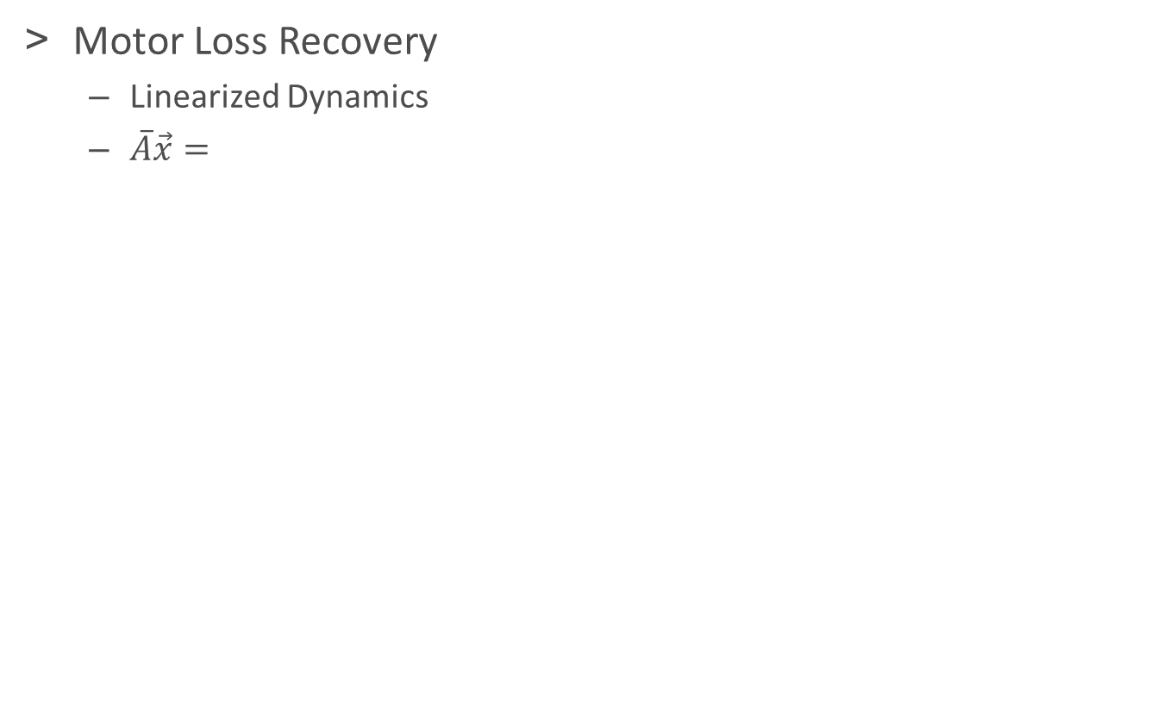


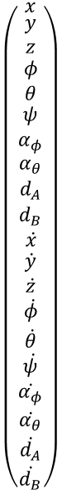
LQR Design
Motor Loss Recovery
Linearized Dynamics
$\overline{A}\vec{x}=$
$$\left(\begin{matrix}\begin{matrix}x \\ \begin{matrix}y \\ z\end{matrix} \\ φ\end{matrix} \\ θ \\ \begin{matrix}ψ \\ α_{φ} \\ \begin{matrix}α_{θ} \\ d_{A} \\ \begin{matrix}d_{B} \\ ẋ \\ \begin{matrix}\dot{y} \\ \dot{z} \\ \begin{matrix}\dot{φ} \\ \dot{θ} \\ \begin{matrix}\dot{ψ} \\ \dot{α_{φ}} \\ \begin{matrix}\dot{α_{θ}} \\ \dot{d_{A}} \\ \dot{d_{B}}\end{matrix}\end{matrix}\end{matrix}\end{matrix}\end{matrix}\end{matrix}\end{matrix}\end{matrix}\right)$$
$$\ddot{x}$$
$$\ddot{y}$$
$$\ddot{φ}$$
$$\ddot{θ}$$

Slide 31







LQR Design
Motor Loss Recovery
Linearized Dynamics
$\vec{u}={\left[u_{A},u_{B},u_{D},\ddot{α_{φ}},\ddot{α_{θ}},\ddot{d_{A}},\ddot{d_{B}}\right]}^{T}$
$\overline{B}=$
Controllability Matrix Full Row Rank
$$\left(\begin{matrix}u_{A} \\ u_{B} \\ \begin{matrix}u_{D} \\ \ddot{α_{φ}} \\ \begin{matrix}\ddot{α_{θ}} \\ \ddot{d_{A}} \\ \ddot{d_{B}}\end{matrix}\end{matrix}\end{matrix}\right)$$
$$\ddot{z}$$
$$\ddot{φ}$$
$$\ddot{θ}$$
$$\ddot{ψ}$$

Slide 32



LQR Design
Motor Loss LQR Gains
$\overline{Q}=diag\left[1,1,1,1,1,1,\frac{16}{π^{2}},\frac{16}{π^{2}},\frac{4}{l_{A}^{2}},\frac{4}{l_{B}^{2}}, 1,1,1,1,1,1,1,1,1,1\right]$
$\overline{R}=diag\left[1,1,1,1,1,1,1\right]$
$\overline{K}=$

Slide 33




















LQR Evaluation
Control Tested on Linearized Trirotor Configuration Model
$$α_{φ}$$
$$x$$
$$φ$$
$$α_{θ}$$
$$y$$
$$θ$$
$$d_{A}$$
$$z$$
$$ψ$$
$$d_{B}$$

Slide 34
















LQR Evaluation
Control Tested on Nonlinear Trirotor Configuration Model
$$α_{φ}$$
$$x$$
$$φ$$
$$α_{θ}$$
$$y$$
$$θ$$
$$d_{A}$$
$$z$$
$$ψ$$
$$d_{B}$$

Slide 35

LQR Evaluation
Results
The Linearized Trirotor System is Controllable
System non-controllable without variable geometry due to coupling
The LQR Gains Fail to Stabilize the Nonlinear Trirotor Model
Likely due to nonlinearity near $α_{θ}=−1.15$
$d_{A}$ and $d_{B}$are used, but not bounded to stay on the arms.

Slide 36
Overview
Motivation and Objectives
Proceeding Work
Model Definition
Dynamic Analysis
LQR Control
Set Point LQR Gain Scheduling
Numerical Optimal Geometric Morphing
Conclusions and Suggestions for Further Study
Acknowledgements
References

Slide 37

Set Point Gain Scheduling
New Control Strategy for Shape-Prescribed Morphing Quadrotor
LQR for a Series of Fixed-Geometry Quadrotor Configurations
Transition Between Gain Matrices During Shape Transition
Seeking Ability to Remain Stable and Controllable Throughout Transition
Initial Test Situation
2 Set Points (Beginning and End)
$α_{θ}=0→−\frac{π}{3}$
$d_{A}=\frac{l_{A}}{2}→l_{A}$
1 and 2 Second Shape Transitions

Slide 38


Set Point Gain Scheduling
2 Second, 2 Set Point Transition at a Hover – Results

Slide 39


Set Point Gain Scheduling
1 Second, 2 Set Point Transition at a Hover – Results

Slide 40


Set Point Gain Scheduling
2 Second, 3 Set Point Transition at a Hover – Results

Slide 41


Set Point Gain Scheduling
Negligible Change Observed Going from 3 Points to 5
More Complex Transitions May Require More Points
Research Remains Ongoing for Potential Publication
3 Set Points
9 Set Points
5 Set Points

Slide 42
Overview
Motivation and Objectives
Proceeding Work
Model Definition
Dynamic Analysis
LQR Control
Set Point LQR Gain Scheduling
Numerical Optimal Geometric Morphing
Conclusions and Suggestions for Further Study
Acknowledgements
References

Slide 43
Numerical Control Optimization
Nonlinear Control Using Constrained Optimizer
Solves for Optimal Control Inputs at Discrete Time Intervals
Assumes Linear Input Function Between Optimized Points
Resolution of Control Points Set By User
Investigating Use of Geometry Changes for Control
Single-Channel Thrust, Evenly Divided Between Motors
Arm Angle Changes Move CL and CG for Pitch and Roll Actuation

Slide 44

Numerical Control Optimization
NLCon Function
-Trajectory Function
-Inequality Constraints
-Bound Shape States
-Equality Constraints
-Set Final/Intermediate State
Master File
-Set Final Time
-Set Control Resolution
-Initialize Control Vector
-Bound Control Vector
-Constrained Numerical Optimization
-NLCon Function
-Cost Function
-Trajectory Function
-Animation Function
-Save Data, Plots, and Videos
Pass/Fail
Control Vector
State
Trajectory
Control Vector
Trajectory Function
-Read Current Control Vector
-Propagate Dynamics Using Given Control
-Outputs State Trajectory
Cost
State
Trajectory
Control Vector
State
Trajectory
Video Frames
Cost Function
-Sum Cost Per Control Step and Pass to fmincon
$$J=\int_{0}^{t_{f}}{\sum{u_{i}^{2}}}+{\left(u_{Throt}−mg\right)}^{2}dt$$
Animation Function
-Reads State Trajectory
-Draw Vehicle at Each Control Step
-Outputs Frames at Each Step

Slide 45

Numerical Control Optimization
Initial Model for Code Structure Validation
2D Model Locked to 1D
$u_{Throt}=mgsec \left(θ\right)$
3 DOF: x, θ, α_{θ}
1 Input:${\ddot{ α}}_{θ}$
Run Using Fixed-Step 4th Order Runge-Kutta (100x Control Resolution)
Test Situation
Move from Hover at x=0 to Hover at x=3
Final Times of 4, 3, and 2 Seconds
41 Point Control Resolution

Slide 46






Numerical Control Optimization
$\ddot{α_{θ}}$ Control
$$t_{f}=3 sec$$
$$t_{f}=4 sec$$
$$t_{f}=2 sec$$

Slide 47





Numerical Control Optimization
State Trajectories
$$t_{f}=3 sec$$
$$t_{f}=4 sec$$
$$t_{f}=2 sec$$

Slide 48






Numerical Control Optimization
$$t_{f}=4 sec$$
$$t_{f}=3 sec$$
$$t_{f}=2 sec$$

Slide 49

Numerical Control Optimization
Adding Additional Dimensionality and Control
2D Model
4 DOF: x, z, θ, α_{θ}
2 Inputs:${\ddot{ α}}_{θ}$, $u_{Throt}$
Convergence Errors with 4th Order Runge-Kutta (100x Control Resolution), Switched to Forward Euler (300x Control Resolution)
Throttle Initialized Close to Hover
Test Situation
Move from Hover at $\left[x,z\right]=\left[0,0\right]$ to $\left[3,3\right]$
Final Times of 4, 3, and 2 Seconds
41 Point Control Resolution

Slide 50

Numerical Control Optimization
Unexpected Local Minimum Found with Zero Throttle Initialization

Slide 51


Numerical Control Optimization
Optimal Controls
$$t_{f}=4 sec$$

Slide 52


Numerical Control Optimization
Optimal Controls
$$t_{f}=3 sec$$

Slide 53


Numerical Control Optimization
Optimal Controls
$$t_{f}=2 sec$$

Slide 54






Numerical Control Optimization
State Trajectories
$$t_{f}=3 sec$$
$$t_{f}=4 sec$$
$$t_{f}=2 sec$$

Slide 55




Numerical Control Optimization
$$t_{f}=4 sec$$
$$t_{f}=3 sec$$
$$t_{f}=2 sec$$

Slide 56

Numerical Control Optimization
Adding Additional Dimensionality and Control
3D Model
7 DOF: x, y, z, φ, θ, α_{φ}, α_{θ}
3 Inputs: ${\ddot{α}}_{φ},{\ddot{ α}}_{θ}$, $u_{Throt}$
Run Using Forward Euler (300x Control Resolution)
Throttle Initialized Close to Hover
Test Situation
Move from Hover at $\left[x,y,z\right]=\left[0,0,0\right]$ to $\left[3,3,3\right]$
Final Times of 5, 4, and 3 Seconds
41 Point Control Resolution

Slide 57



Numerical Control Optimization
$$t_{f}=5 sec$$

Slide 58



Numerical Control Optimization
$$t_{f}=4 sec$$

Slide 59



Numerical Control Optimization
$$t_{f}=3 sec$$

Slide 60






Numerical Control Optimization
$$t_{f}=5 sec$$
$$t_{f}=4 sec$$
$$t_{f}=3 sec$$

Slide 61
Conclusions
Dynamic Modelling
Symmetric 3D Dynamic Model Found
LQR Control
Stabilizing Control Found
Set Point Gain Scheduling
Simple Transitions Can Be Covered by a 3-Point Model
Nonlinear Optimal Control
Controllability via Geometry Transformation Verified
Program Written and Ready for Further Trials

Slide 62
Suggestions for Further Study
Dynamic Modelling
Incorporate Internal Torques to Allow Asymmetric Shapes
Incorporate Drag and Gyroscopic Effects
LQR Control
Continue Troubleshooting Lack of Return to Origin
Set Point Gain Scheduling
Model Trajectories and More Complex Transformations
Nonlinear Optimal Control
Continue to Add Control Dimensionality
Implement ODE45 Dynamics Modeling
Investigate Effects of Changes to Cost Function

Slide 63



Acknowledgements

Slide 64
References
¹ S. Bouabdallah, A. Noth, and R. Siegwart, “PID vs LQ control techniques applied to an indoor micro quadrotor,” in Intelligent Robots and Systems, 2004. (IROS 2004). Proceedings. 2004 IEEE/RSJ Internation Conference on, vol. 3, pp. 2451-2453. Sept 2004.
² D. Mellinger, N. Michael, M. Shomin, and V. Kumar, “Recent advances in quadrotor capabilities,” in Robotics and Automation (ICRA), 2011 IEEE, International Conference on, pp. 2964-2965, May 2011.
³ S. Sadr, S.A.A. Moosavian, and P. Zarafshan, “Dynamics modeling and control of a quadrotor with swing load,” Journal of Robotics, vol. 2014, 2014.
⁴ A.E. Jimenez-Cano, J. Martin, G. Heredia, A. Ollero, and R. Cano, “Control of an aerial robot with multi-link arm for assembly tasks,” in Robotics and Automation (ICRA), 2013 IEEE Converence on, pp. 4916-4921, May 2013.
⁵ J.D. Becker, Modeling and Control of a Quadrotor with Dynamic Inertia. Masters Thesis, 2013.

Slide 65
Thank you for your time and attention
Questions?

